Slide 1
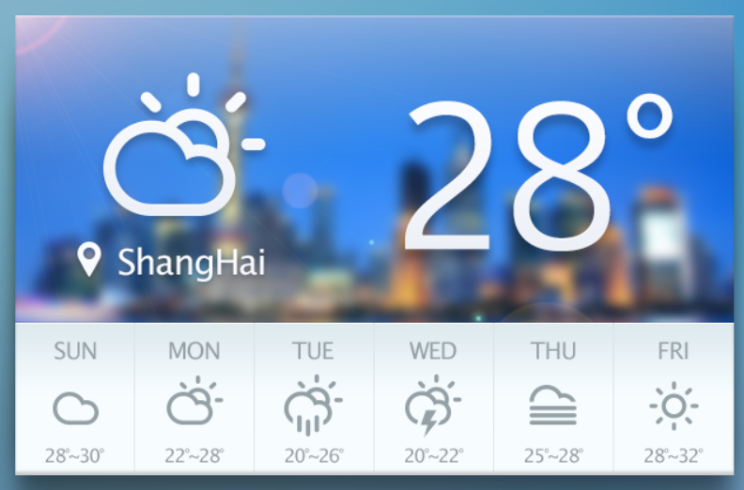
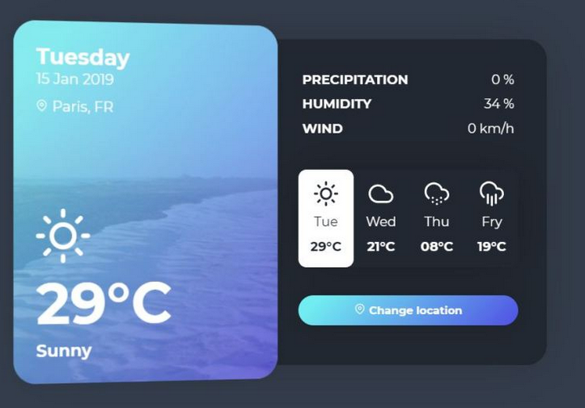
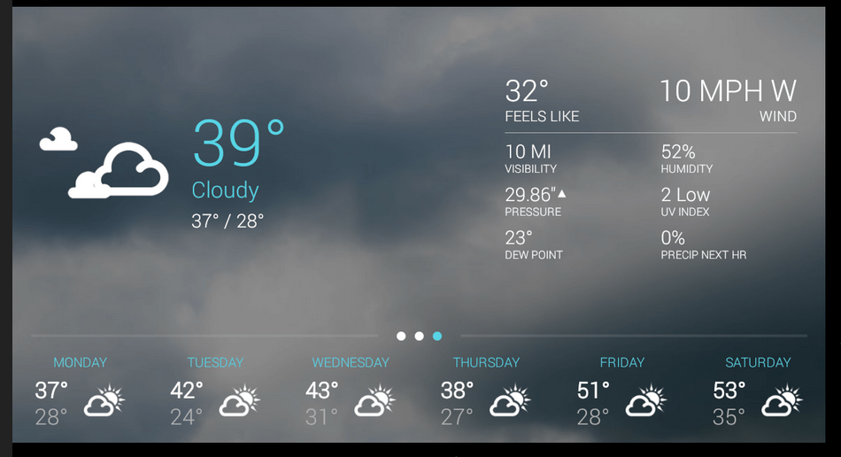
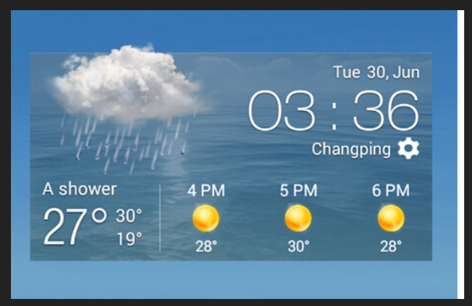
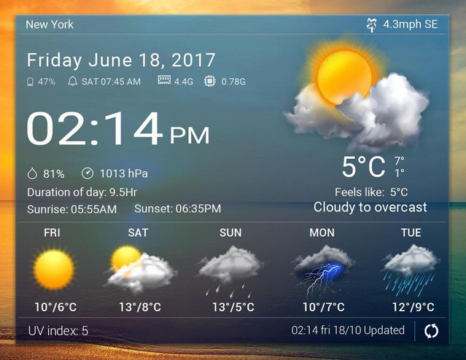
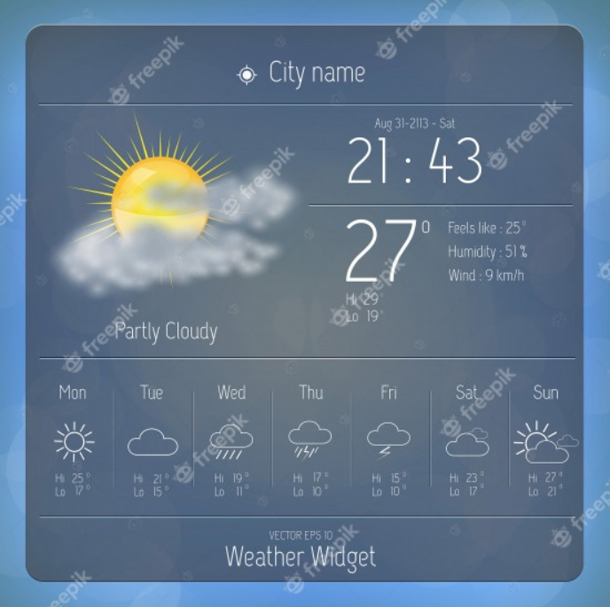
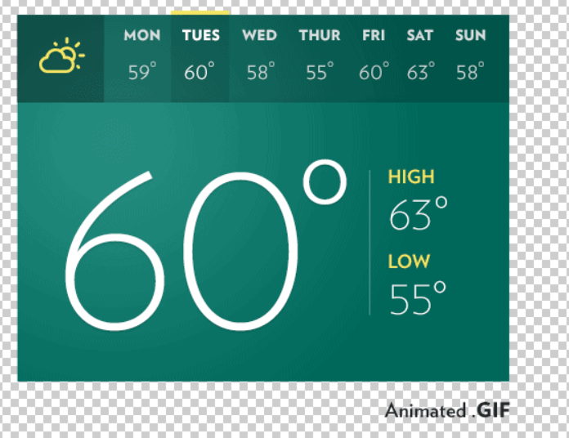
Notes:
Choosing Web Fonts: A Beginner’s Guide: https://design.google/library/choosing-web-fonts-beginners-guide/

Slide 2

Your Travel Planner
Your Travel Planner
Your Travel Planner
Your Travel Planner
Your Travel Planner
Your Travel Planner
Your Travel Planner

Slide 3
Your Travel Planner
Your Travel Planner
Notes:
Choosing Web Fonts: A Beginner’s Guide: https://design.google/library/choosing-web-fonts-beginners-guide/

Slide 4




Your Travel Planner
Where would you like to go?
When?
Let’s go!
Erfurt, Germany
23:35
Local time
23⁰C
Humidity:
Wind:
Pressure:
M on
Tue
Wed
Thu
Fri
Sat
Sun
13⁰ - 18⁰
13⁰ - 18⁰
13⁰ - 18⁰
13⁰ - 18⁰
13⁰ - 18⁰
13⁰ - 18⁰
13⁰ - 18⁰
Palette 1
Palette 2
Notes:
Choosing Web Fonts: A Beginner’s Guide: https://design.google/library/choosing-web-fonts-beginners-guide/
https://materialdesignicons.com/

Slide 5
Your Travel Planner
Where would you like to go?
When?
Let’s go!
Erfurt, Germany
23:35
Local time
23⁰C
Humidity:
Wind:
Pressure:
Mon
Tue
Wed
Thu
Fri
Sat
Sun
13⁰ - 18⁰
13⁰ - 18⁰
13⁰ - 18⁰
13⁰ - 18⁰
13⁰ - 18⁰
13⁰ - 18⁰
13⁰ - 18⁰
Palette 1

Slide 6

Your Travel Planner
My trip to:
enter location
Departing:
DD/MM/YYY
Let’s go!
Palette 1

Slide 7
Your Travel Planner
My trip to: Erfurt, Germany
Departing: 12/09/2021
Save trip
Remove trip
The trip to Erfurt, Germany is x days away.
Today’s weather:
23:35
Local time
23⁰C
Humidity:
Wind:
Pressure:
Weather forecast:
Mon
Tue
Wed
Thu
Fri
Sat
Sun
13⁰ - 18⁰
13⁰ - 18⁰
13⁰ - 18⁰
13⁰ - 18⁰
13⁰ - 18⁰
13⁰ - 18⁰
13⁰ - 18⁰
My trip to:
enter location
Departing:
DD/MM/YYY
Let’s go!
Palette 1

Slide 8
My trip to: Erfurt, Germany
Departing: 12/09/2021
Save trip
Remove trip
The trip to Erfurt, Germany is x days away.
Today’s weather:
23:35
Local time
23⁰C
Humidity:
Wind:
Pressure:
Weather forecast:
Mon
Tue
Wed
Thu
Fri
Sat
Sun
13⁰ - 18⁰
13⁰ - 18⁰
13⁰ - 18⁰
13⁰ - 18⁰
13⁰ - 18⁰
13⁰ - 18⁰
13⁰ - 18⁰
Palette 1
Palette 2

Slide 9
Your Travel Planner
Where would you like to go?
When?
Let’s go!

Slide 10
Your Travel Planner
Unfortunately, I don’t know this place. Please choose another location.
asdsadasd
When?
Let’s go!
Palette 2

Slide 11
Your Travel Planner
Erfurt
24/08/2021
Let’s go!
Erfurt, Germany
23:35
Local time
Erfurt, Dom
23⁰C
Humidity:
Wind:
Pressure:
Mon
Tue
Wed
Thu
Fri
Sat
Sun
13⁰ - 18⁰
13⁰ - 18⁰
13⁰ - 18⁰
13⁰ - 18⁰
13⁰ - 18⁰
13⁰ - 18⁰
13⁰ - 18⁰

